Slide 1
MyGov Collaborator Training
Farmers market vendor training for applications

Slide 2
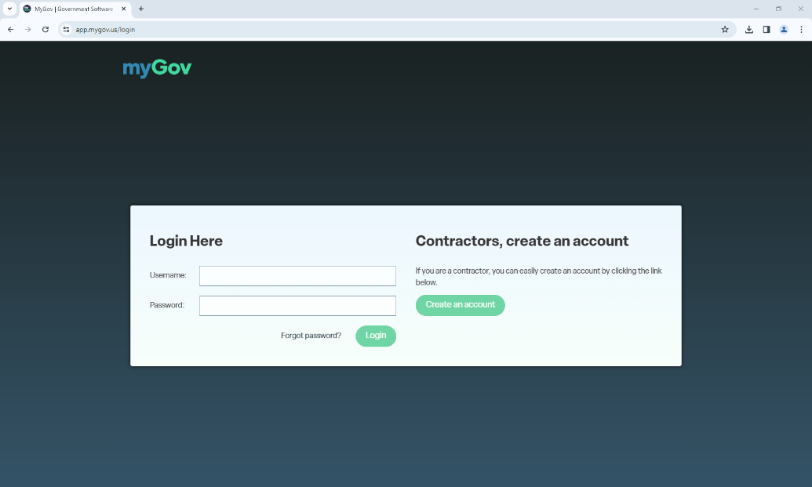
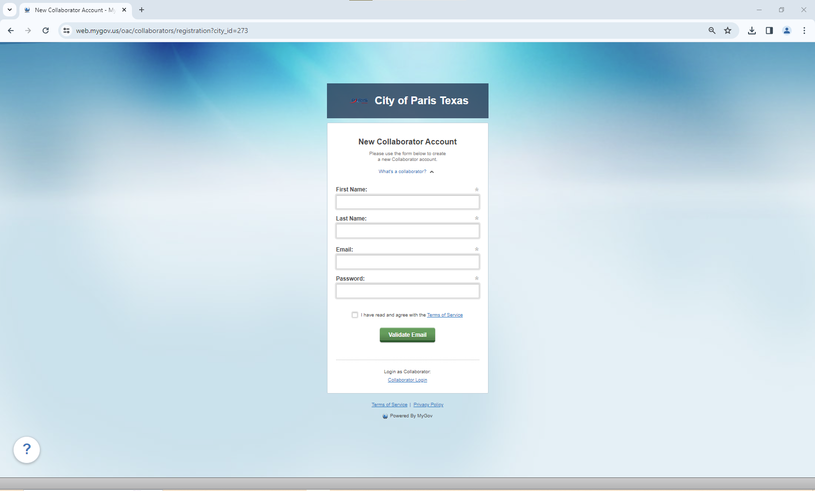
Making an Account
Open link https://app.mygov.us/login
Create up account as collaborator.

Slide 3
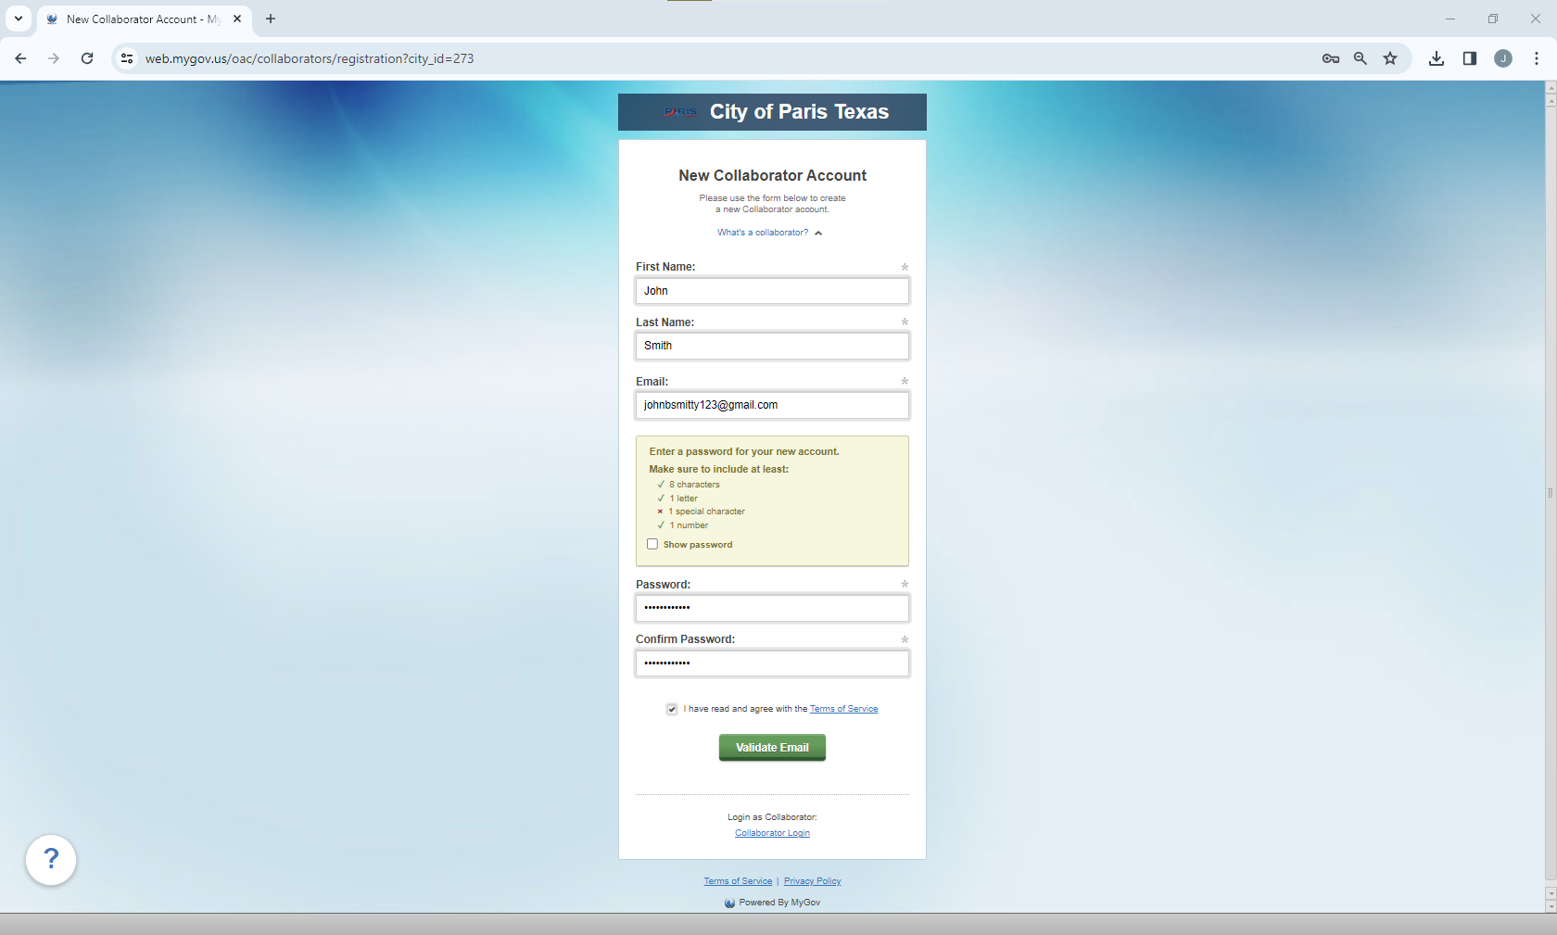
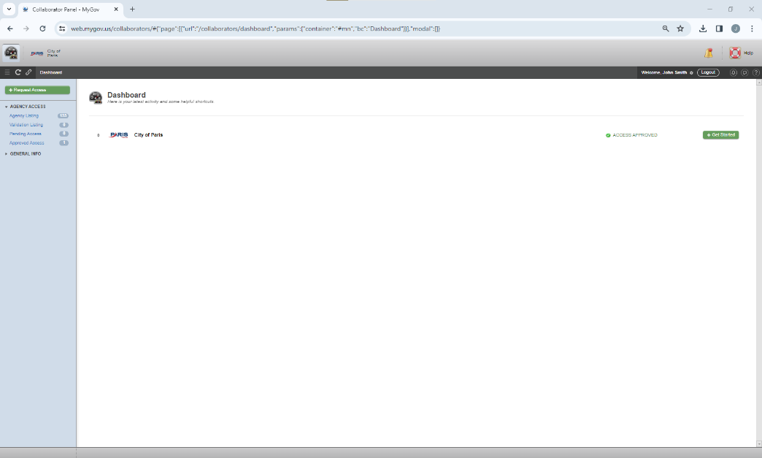
Getting Started
Finish putting in your information for your account.
Click “Get Started” on the City of Paris link.
How it works:

Slide 4
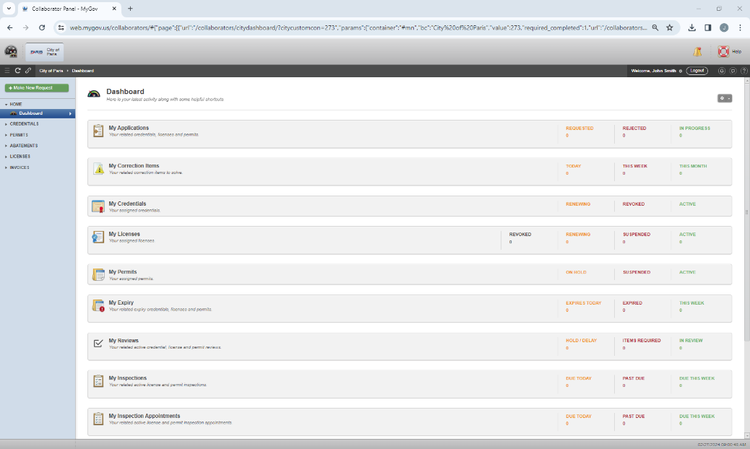
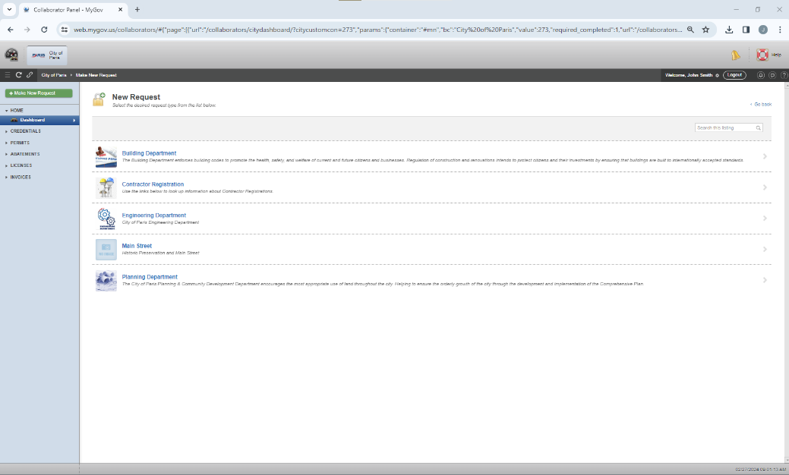
Making a Request
Click “make new request’ in the top left corner of the screen.
Select Main Street.

Slide 5
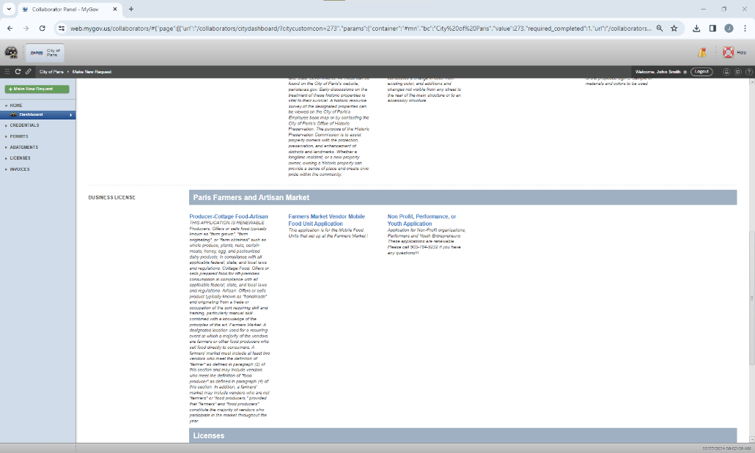
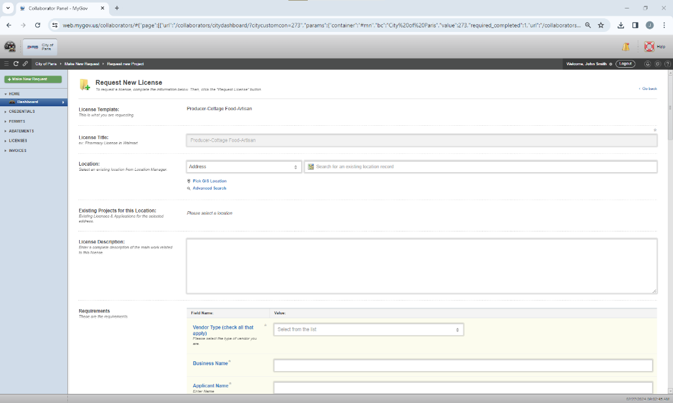
Application Process
Scroll down to the “Business License” module.
Choose desired application type.
Take care to upload all required documentation for your vendor type. ** enter the location of the Market Square pavilion 400 SW 1st ST.
The vendor applications will be reviewed. If the application is complete an invoice will be sent

Slide 6
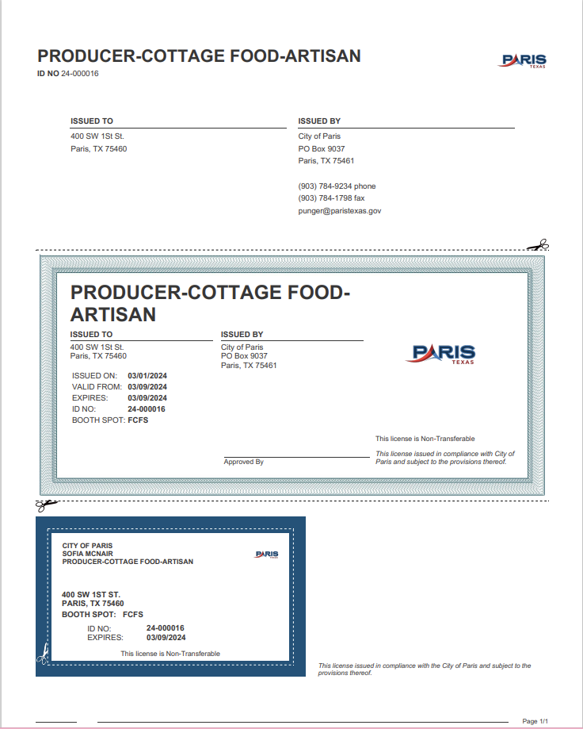
This is what your new Business License will look like
with the new MyGov system sign up.
PLEASE REMEMBER THESE KEY ITEMS
ALWAYS have everything filled out and completed or the application will be denied/delayed.
If the application is delayed or denied, a note with correction items will be entered.
IF the application is completed, the application will need to be accepted and approved in house before any payments are made so, please make sure the applications are submitted Thursday by 5:00pm
INVOICES have to be paid no later than Friday at 12:00pm. We need this time to be able to assign your booth spot and generate your business license for you to attend the Farmers Market.

Slide 7
Q&A
How do I know if my application has been accepted?
You will receive an email or you can check the status of your application under “Licenses” then “Applications” Accepted means we have received your application and it is under review.
How do I pay online?
Once you go under “Licenses” then “Applications”, The “Pay Invoice” option will be shown on the right side of the screen, or you can open the application and pay that way.
How do I download the Business License?
Once you go under “Licenses” then “Applications”, you can go to the top and click the “Documents” tab. Go to “Generated Documents” and you will be able to download and print your document there.

